Slide 1
Roadway BMPs –
Common Design Errors

Slide 2
Roadway vs. Typical Site Construction
Typical Site Construction
  Compact, one discharge point, control over drainage configuration, no off-site run on
Roadway Construction
  Spread out, multiple discharge points, limited ability to change runoff patterns, significant off-site run on, narrow area to work in with limited space for BMPs

Slide 3
-40 Acre Disturbance
-1 Discharge Point
-1 Post-Construction BMP
-40 Acre Disturbance
-9 Distinct Stream Crossings
-Many Post-Construction BMPs

Slide 4
Overview
Ohio EPA CGP vs. ODOT L&D Volume 2
Earth Disturbing Area (EDA)
Impervious Area
Treatment Requirements and Treatment Credit
Quality vs. Quantity Treatment
Manufactured Systems
Projects that Don’t Require Post-Construction BMPs

Slide 5
Overview
Ohio EPA CGP vs. ODOT L&D Volume 2
Earth Disturbing Area (EDA)
Impervious Area
Treatment Requirements and Treatment Credit
Quality vs. Quantity Treatment
Manufactured Systems
Projects that Don’t Require Post-Construction BMPs

Slide 6
Ohio EPA CGP vs. ODOT L&D Vol. 2
Permit:
  The construction of new roads and roadway improvement projects by public entities (i.e. the state, counties, townships, cities, or villages) may implement post-construction BMPs in compliance with the current version (as of the effective date of this permit) of the Ohio Department of Transportation’s “Location and Design Manual, Volume Two Drainage Design” that has been accepted by Ohio EPA as an alternative to the conditions of this permit.

Slide 7
Ohio EPA CGP vs. ODOT L&D Vol. 2
ODOT’s L&D Vol. 2: alternative to post-construction BMP requirements
L&D post-construction BMP guidance reviewed by Ohio EPA
Conformance with ODOT’s L&D a condition of funding from FHWA

Slide 8
Overview
Ohio EPA CGP vs. ODOT L&D Volume 2
Earth Disturbing Area (EDA)
Impervious Area
Treatment Requirements and Treatment Credit
Quality vs. Quantity Treatment
Manufactured Systems
Projects that Don’t Require Post-Construction BMPs

Slide 9
Earth Disturbing Area (EDA)
Permit:
  - For the purposes of this permit, construction activities include any clearing, grading, excavating, grubbing and/or filling activities that disturb one or more acres.
  - This permit also authorizes storm water discharges from support activities (e.g., concrete or asphalt batch plants, equipment staging yards, material storage areas, excavated material disposal areas, borrow areas)”
  - For all construction activities that will disturb one or more acres of land…, the post-construction (BMPs) shall manage storm water

Slide 10
Earth Disturbing Area (EDA)
L&D:
  Project EDA: EDA that occurs within the project construction limits
  Contractor EDA: EDA from support activity sources such as field offices, batch plants, borrow/waste pits, and temporary access routes.
  Total EDA = Project EDA + Contractor EDA

Slide 11
Earth Disturbing Area (EDA)
Total EDA = Project EDA + Contractor EDA
When Total EDA >= 1ac; NOI required
When Project EDA >= 1ac; BMP required
Treatment Requirements based on Project EDA (not Total EDA)
Example
  Project EDA = 0.9 ac
  Contractor EDA = 0.15 ac
  Total EDA = 1.05 ac
  NOI required
  Post-construction BMP not required

Slide 12
Overview
Ohio EPA CGP vs. ODOT L&D Volume 2
Earth Disturbing Area (EDA)
Impervious Area
Treatment Requirements and Treatment Credit
Quality vs. Quantity Treatment
Manufactured Systems
Projects that Don’t Require Post-Construction BMPs

Slide 13
Impervious Area
For post-construction BMP calculations: consider all area within existing right-of-way to be impervious, even grassy areas.
In new right-of-way, grass is considered pervious and paved area is considered impervious

Slide 14
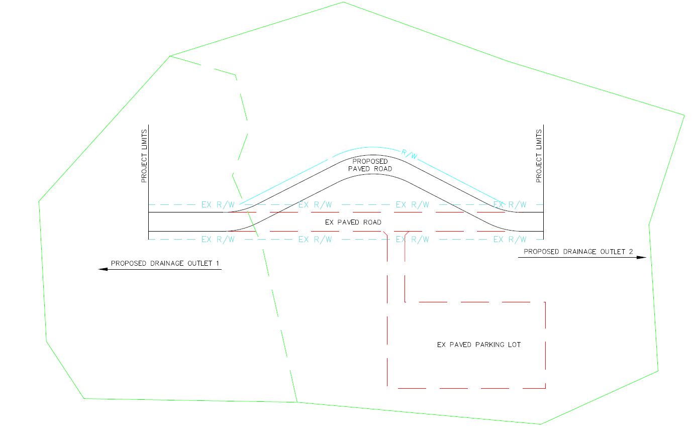
Impervious Area
Ain
R/W
EX R/W
EX R/W
EX R/W
EX R/W
Aix
EX R/W
EX R/W
EX R/W
EX R/W

Slide 15
Overview
Ohio EPA CGP vs. ODOT L&D Volume 2
Earth Disturbing Area (EDA)
Impervious Area
Treatment Requirements and Treatment Credit
Quality vs. Quantity Treatment
Manufactured Systems
Projects that Don’t Require Post-Construction BMPs

Slide 16
Treatment Requirements & Treatment Credit
Ohio EPA: based on WQ_{V}
ODOT L&D: based on Area
  Required Treatment = Project EDA * T%
  Treatment credit only for area within right-of-way
  Credit given to all right-of-way area, not just disturbed area
  BMPs sized for full tributary area

Slide 17
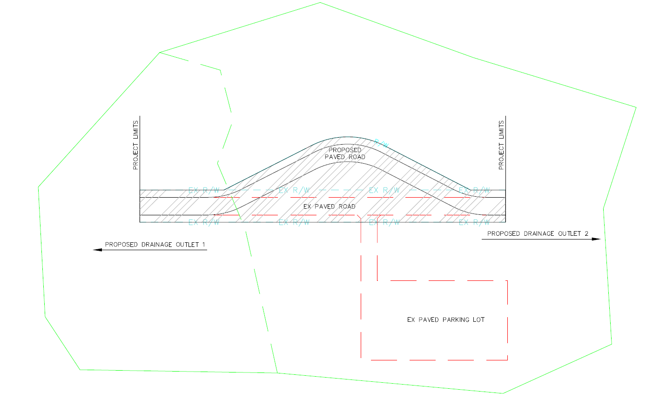
Treatment Requirements & Treatment Credit
Drainage Area 2 = 5 ac
0.6 ac
1.1 ac
Total Treatment credit for BMP1 and BMP2 = 1.7 ac
Drainage Area 1 = 2 ac

Slide 18
Overview
Ohio EPA CGP vs. ODOT L&D Volume 2
Earth Disturbing Area (EDA)
Impervious Area
Treatment Requirements and Treatment Credit
Quality vs. Quantity Treatment
Manufactured Systems
Projects that Don’t Require Post-Construction BMPs

Slide 19
Quality vs. Quantity Treatment
Permit: post-construction storm water practices shall provide perpetual management of runoff quality and quantity
Permit: development that creates less than one acre of impervious surface or discharges to a large river is considered to have a negligible impact to physical stream integrity
Ohio EPA BMPs all address quality and quantity

Slide 20

Quality vs. Quantity Treatment
L&D: Some BMPs address only quality, only quantity, or both
Quality only BMPs:
  Vegetated Filter Strips
  Vegetated Biofilters
  Manufactured Systems
Quantity only BMPs:
  Underground Detention
  Stream Grade Control
Quality and Quantity BMPs:
  Extended Detention / Retention
  Bioretention
  Infiltration (Basin / Trench)
  Constructed Wetland

Slide 21

Quality vs. Quantity Treatment
If this new impervious area is less than one acre,
water quantity treatment is not required.
R/W
EX R/W
EX R/W
EX R/W

Slide 22
Overview
Ohio EPA CGP vs. ODOT L&D Volume 2
Earth Disturbing Area (EDA)
Impervious Area
Treatment Requirements and Treatment Credit
Quality vs. Quantity Treatment
Manufactured Systems
Projects that Don’t Require Post-Construction BMPs

Slide 23
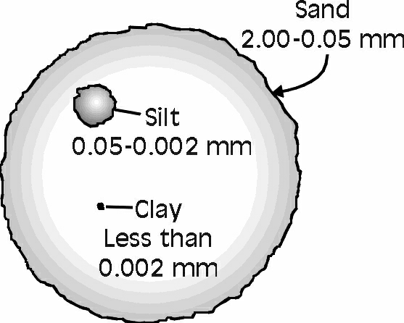
Manufactured Systems
80% TSS Removal

Slide 24
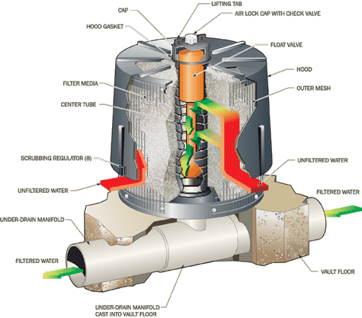
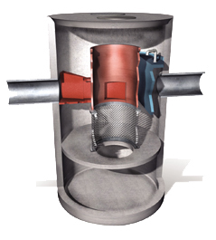
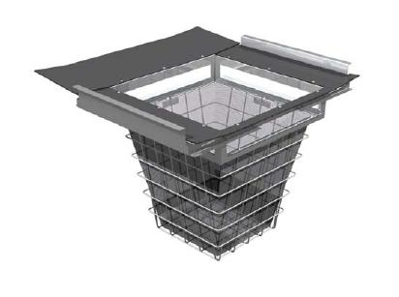
Manufactured Systems
Cartridge & Membrane Filters: 80% NJDEP Sand
Hydrodynamic Separators: 80% ODOT Sand, 50% NJDEP
Catch Basin Inserts: May Capture >200 microns, reg. maint.
Cartridge (Contech)
Hydro. Sep. (Contech)
Basin Insert (Contech)

Slide 25
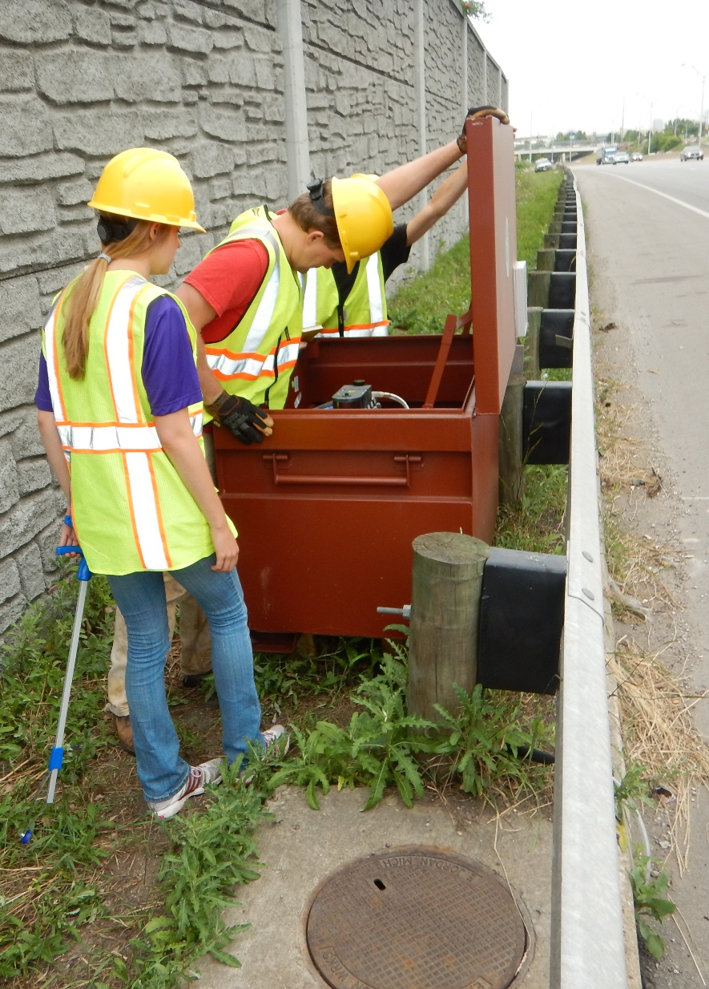
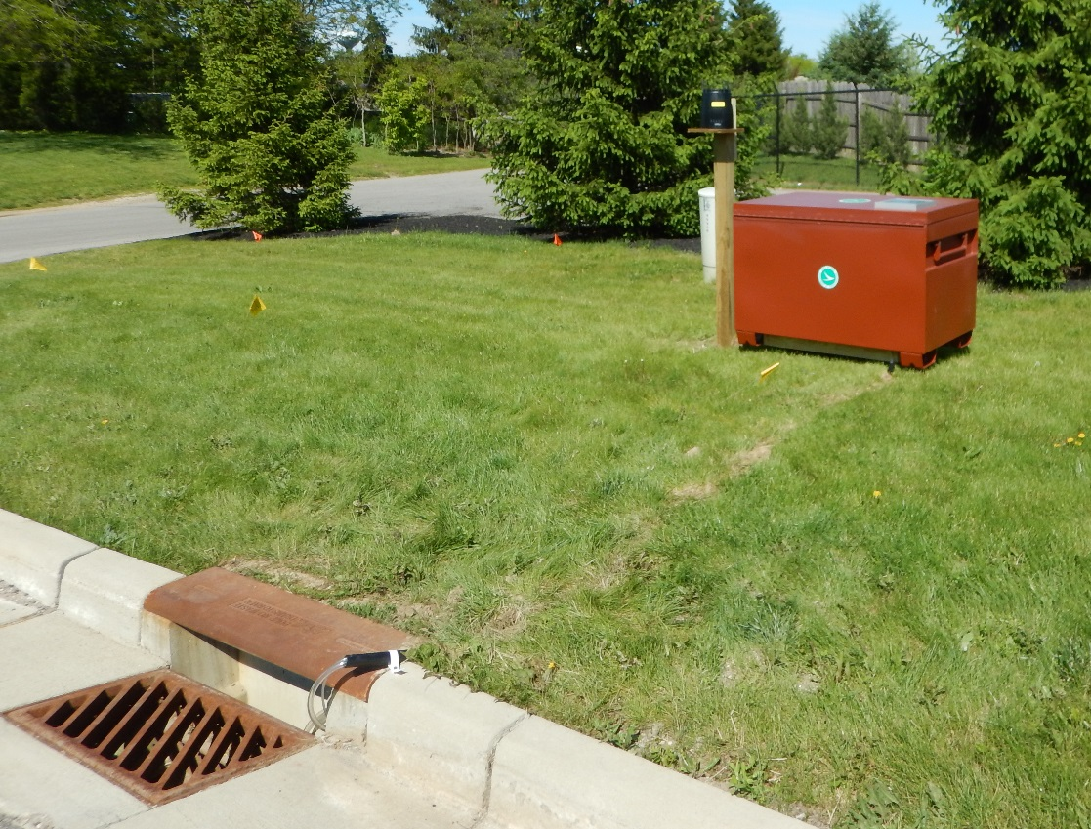
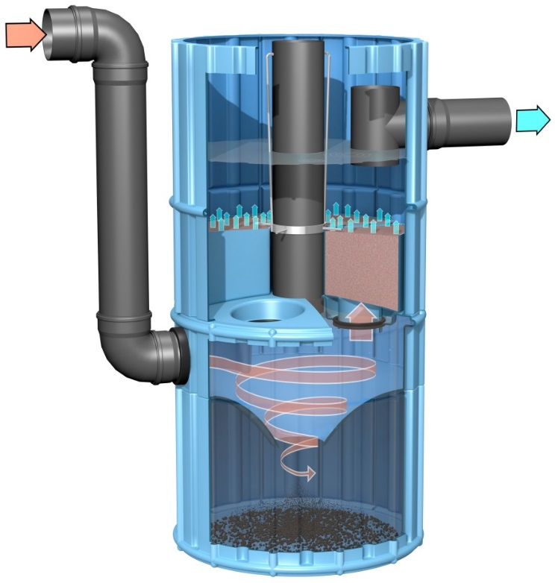
Manufactured Systems
Image: 3P Technik UK

Slide 26
Overview
Ohio EPA CGP vs. ODOT L&D Volume 2
Earth Disturbing Area (EDA)
Impervious Area
Treatment Requirements and Treatment Credit
Quality vs. Quantity Treatment
Manufactured Systems
Projects that Don’t Require Post-Construction BMPs

Slide 27
No Post-Construction BMPs Required
New utility line, fence, guard rail, or noise wall projects
Routine Maintenance Activities
  US EPA: Activity that is performed to maintain the original line and grade, hydraulic capacity, or original purpose of the site
  US EPA: Applicable to any size site
  Ohio EPA: Website listing typical routine maintenance activities
  Ohio EPA: Limit routine maintenance to < 5 acres

Slide 28
No Post-Construction BMPs Required
Routine Maintenance Activities (< 5 acres Total EDA)
  Repair/replace fence, guard rail, noise wall, signs, lighting, signals, culverts, curbs, sidewalk, utility lines
  Bridge repair/replace – includes approach, abutments, and deck
  Tree/brush removal, ditch cleanout, linear grading (for proper drainage)
  Land slide repair – includes grading/repairing features affected by slide
  Unpaved/Gravel roadway or shoulder maintenance – dragging, blading, adding aggregate, etc.
  Full depth pavement repair/replace – no changes to the purpose, horizontal alignment, or hydraulic capacity and no additional impervious area is added outside of the existing edge of paved roadway.

Slide 29
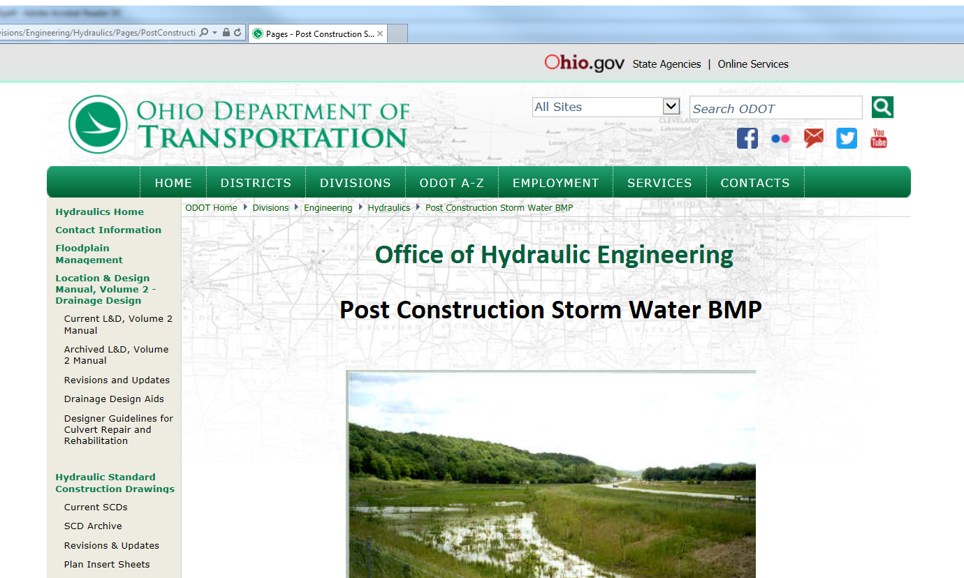
Confused? Use ODOT’s Design Resources!

Slide 30
Questions ?
Jon Prier, P.E.
jonathan.prier@dot.ohio.gov
614-644-1876

